Slide 1
Live Chat Application

Slide 2
User Research
The postulates for our research and study are as follows:
User will want to be assigned to a CSR ASAP
User will want to use the app on mobile
User will want the chat to be kept private
User may want to get back to the CSR they talked to before

Slide 3
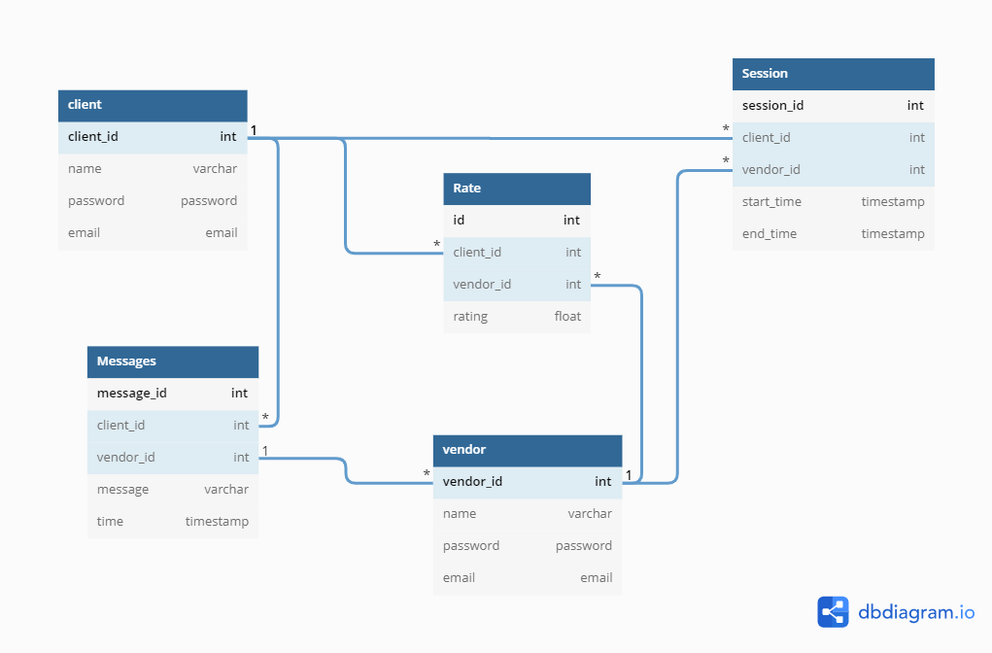
Database Schema
This is a general Implementation. The schema will change w.r.t requirements

Slide 4
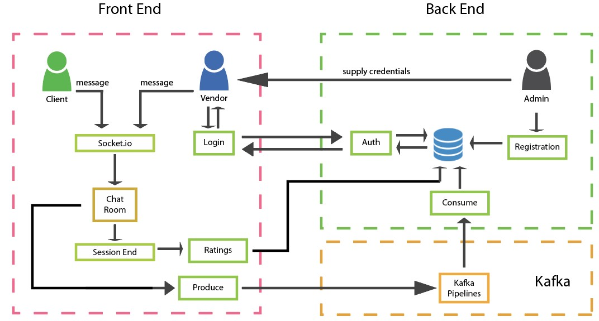
Software Structure

Slide 5
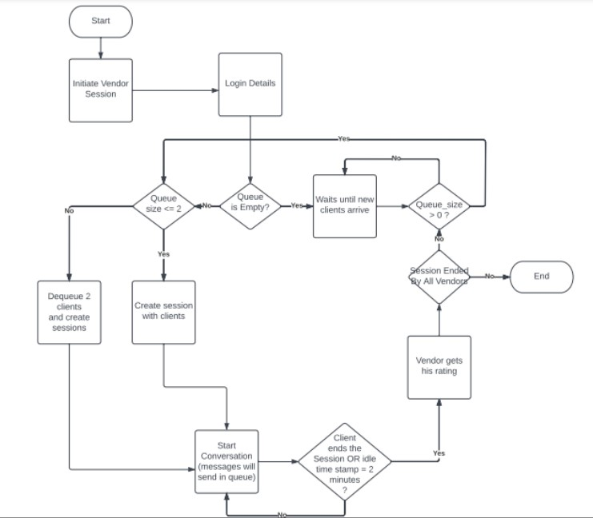
General Flow
Vendors’ Perspective

Slide 6
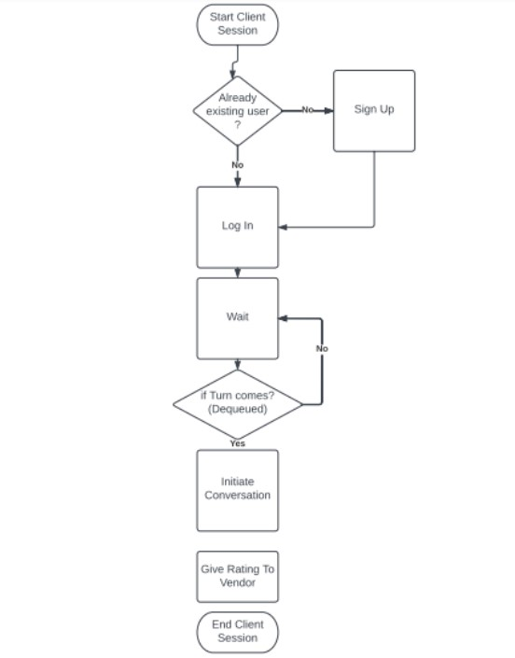
General Flow
Clients’ Perspective

Slide 7
Test Reports

Slide 8
